Slide 1

Allocation2.0/Tranche1 Test and Qualification Guide
Version 1.1

Slide 3
Versie beheer
Version | Changes
1.1 | New document versions of Nedu and TenneT documentation in slides 10,13,15 due to NEDU RFCs 249.4, 249.5 and 249.6. Besides this update in certificate. First changes to clarify prequalification testing (semantic tests) on slide 26. More will follow 17-9-2021
100001

Slide 4
Test and qualification process
Connectivity test
Semantic test
Qualification test
Get started
Go-live
100001

Slide 5
Test and Qualification process
Market parties are obliged to qualify before they are allowed to participate in the message exchange (as described in the Dutch Net Code, article 13.33)
For Allocation2.0/Tranche1 all BRP, MRP, DSO and TSO should requalify. Mainly to secure all parties talk the same messaging language.
The first step is a set of activities labeled as “ getting started”
The second step is connectivity testing with MMC-Hub
The third step is functional testing, which is specific for each Market Document. (“measurement series”, “stand-volume”, …)
The fourth step is qualification test.
The final step is go-live
Test phase
Qualification phase
Q
Connectivity testing
Semantic testing
Executing qualification scenarios

Slide 6

Get started
Download documents
Exchange security certificates

Slide 7
To get started
Sequence
mijnNedu
myTenneT
100001

Slide 8
To get started
Go to MijnNEDU to find relevant functional documentation (displayed in slide 8)
https://nedunl.sharepoint.com/sites/ThemaRelease2021
Under: Release/ThemaRelease 2021
100001
Relevant functional documentation to start software implementation:
Change descriptions (Issues)
Business requirements specification (BRS)
Business services (Service beschrijvingen)
XSD (bericht definities)
Example messages (voorbeeldberichten)
All documents are necessary for MRP, BRP, DSO, TSO. There are 2 exceptions.
  The BRP do not need Business Service Uitwisselen meetgegevens volumes installatie
  The TSO-G does not need
    Business Service Uitwisselen meetgegevens volumes en meterstanden
    Business Service Uitwisselen meetgegevens volumes installatie
    Business Service Uitwisselen herzieningsverzoeken

Slide 9
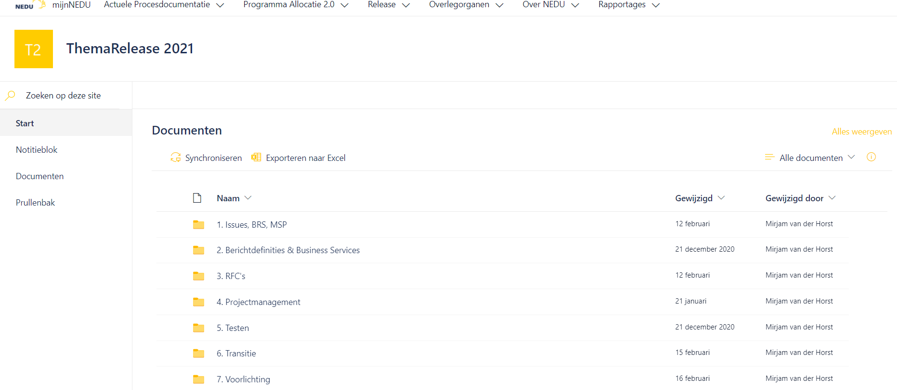
To get started
Go to MijnNEDU under Release/ThemaRelease2021
100001

Slide 10
Latest Versions dd. May 20th 2021
Title | version
IC231 | 1.0
IC248 | 1.0
IC249 | 1.0
BRS Meetgegevens en reclamaties meetgegevens GV | 4.0
MSP NEDU Retailprocessen | 1.5
Business Service Uitwisselen meetgegevens tijdseries | 5.0
Business Service Uitwisselen meetgegevens volumes en meterstanden | 3.0
Business Service Uitwisselen meetgegevens volumes installatie | 3.0
Business Service Uitwisselen herzieningsverzoeken | 3.0
Example messages (voorbeeldberichten) | 1

Slide 11
To get started
Go to MyTenneT to find relevant MMC-Hub documentation
In case you do not have myTenneT access please contact tennetccc@tennet.eu
Search for “MMC-Hub” in Subject there you find:
    MMC-Hub Web Services Guide
    MMC-Hub Questionnaire other org roles
    Security certificates (transport & signing)
    The rest of the documentation found under MMC-Hub is not applicable for Allocatie2.0!

Slide 12
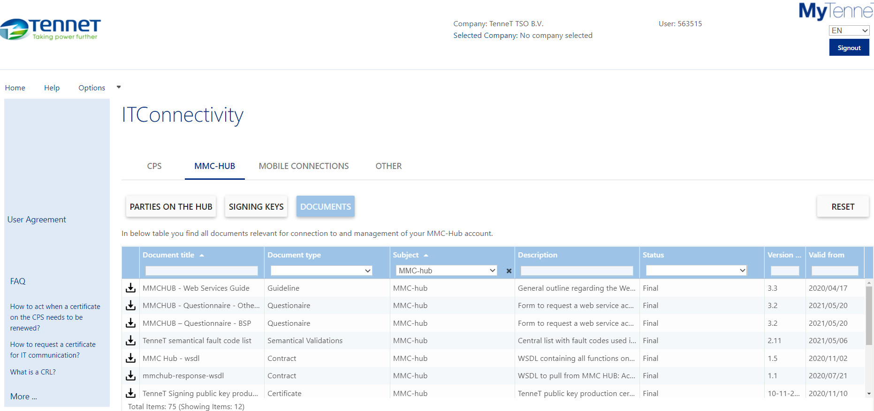
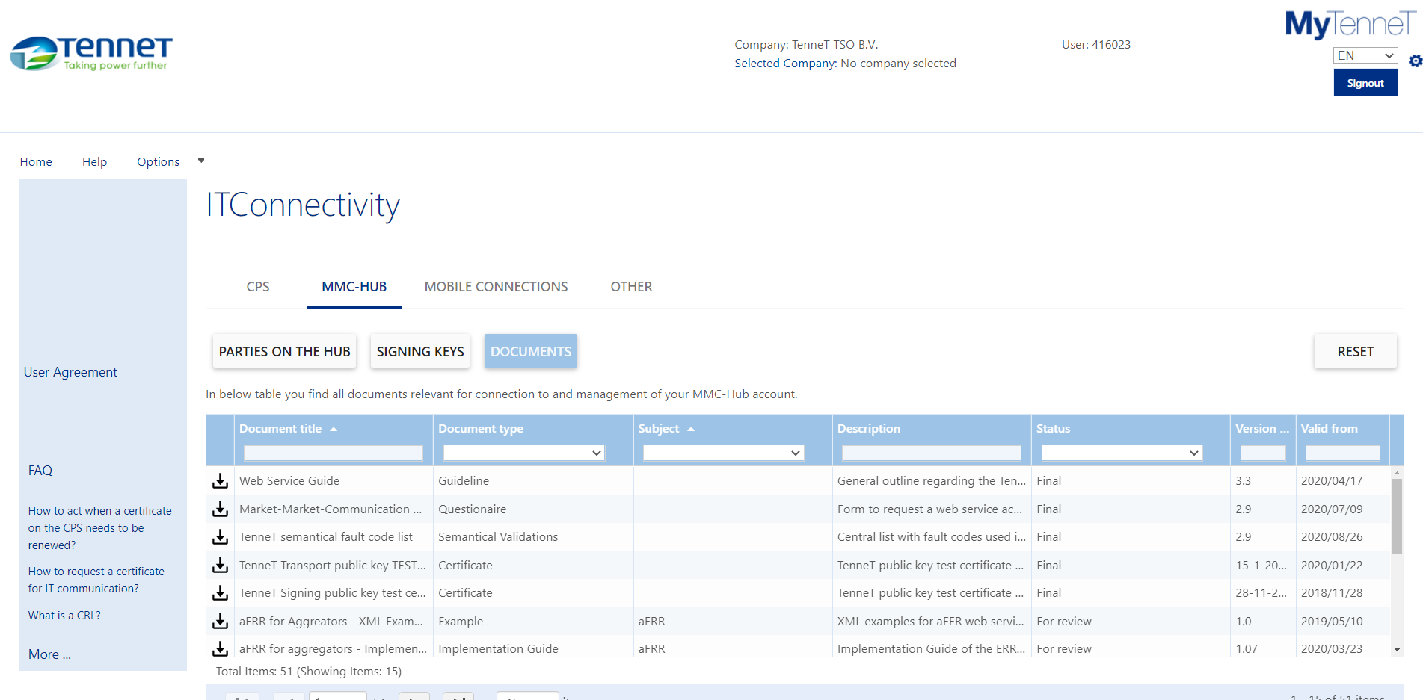
To get started
Go to MyTenneT (IT connections/MMC Hub/Documention) to find relevant MMC-Hub documentation
100001
Select MMC-Hub in the Subject

Slide 13
Necessary documents
Title | version
Web Services Guide | 3.4
MMC-HUB - Questionnaire - Other Org Roles | 3.2
TenneT Transport public key test certificate | 20-04-2021
TenneT Signing public key test certificate | 17-11-2020
TenneT TQF Transport public key certificate | 16-12-2020
TenneT TQF Signing public key certificate | 29-01-2021
TenneT Transport public key production certificate | 28-04-2021
TenneT Signing public key production certificate | 10-11-2020
TQF manual | Not yet available

Slide 14
To get started
Go to MyTenneT to find relevant MMC-Hub documentation
100001
Search for “measurements&allocation” in Subject there you find:
    “Measurements_allocation technical guide”
    the list of necessary wsdl

Slide 15
Necessary documents
Title | version
Measurement_allocation Technical guide | 1.3
MeasurementSeries-wsdl | 2.0
mmchub-MeasurementSeries-wsdl | 2.0
VolumeSeries-wsdl | 2.0
mmchub-VolumeSeries-wsdl | 2.0
VolumeInstallationSeries-wsdl | 2.0
mmchub-VolumeInstallationSeries-wsdl | 2.0
MeasurementSeriesRevision-wsdl | 2.0
mmchub-MeasurementSeriesRevision-wsdl | 2.0
AllocationVolumeRevision-wsdl | 2.0
mmchub-AllocationVolumeRevision-wsdl | 2.0

Slide 16
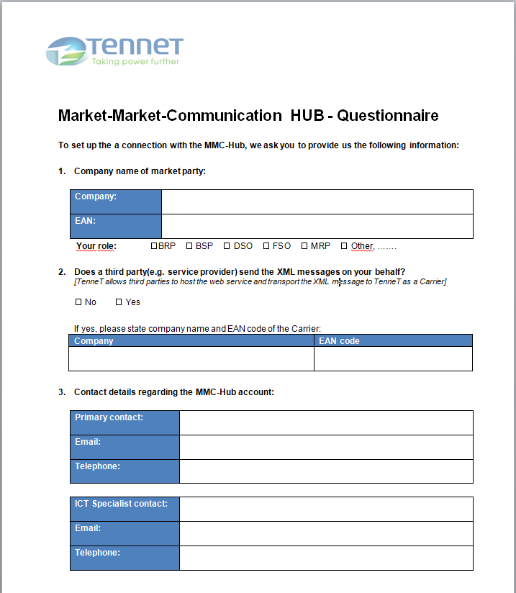
To get started
Fill out the Questionnaire
The Questionnaire is available at MyTenneT
For ThemaRelease2021 You have to fill out webservices 1,2,3 and the section Measurements & Allocations.
Fill out which web services you wish to connect to and whether you are choosing the PUSH or the PULL option
Send the filled-out-Questionnaire to allocatie2@tennet.eu

Slide 17
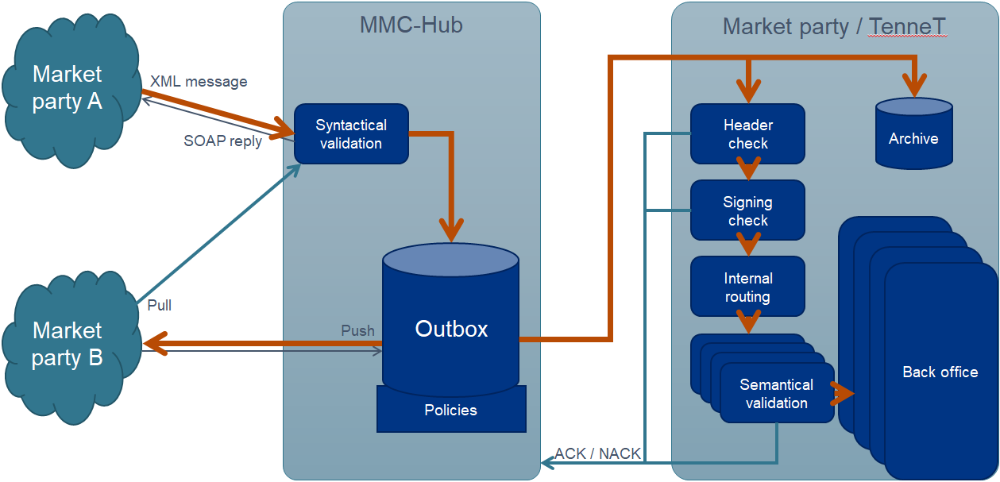
Security Certificate requirements
The party has to deliver their own security certificates for use on the MMC-Hub, retrieved from the Certificate Authority of their choice
The Carrier delivers transport certificates (SSL/TLS), the Sender (market party) delivers signing certificates (S/MIME)
Certificates have to comply to
the rules set in the Web
Services guide. TenneT will
validate certificates before
installing them
Transport security & encryption
Message signing

Slide 18
To get started
send your security certificates
Ask allocatie2@tennet.eu for sftp request to deliver 4 public keys of your test and production security certificates

Slide 19
To get started
TenneT configuration of certificates and TQF access
When TenneT has received questionnaire and certificates we need 2 weeks for approval and configuration of certificates and configure TQF access
In case of rejection of certificates TenneT application management will contact you and will discuss the next steps
When certificates are accepted and installed, this phase ends

Slide 20

MMC-Hub Connectivity test.
Possible from 1-6-2021 onward

Slide 21
Connection test prerequisites
Install TenneT TQF transport and signing certificates on your own systems
Configure TenneT TQF environment URL as endpoint (see Measurement_allocation Technical guide )
Check MijnNedu and MyTenneT base documentation set for changes
In case you have implementation according to the latest version set: Contact TenneT’s qualification team (allocatie2@tennet.eu) to
  Check installation of your certificates on TenneT side
  Align on which of the measurement and allocation messages to be tested during the connection test
  Align on start date connection test and testplan
  Align on how to login TQF portal and how to use it

Slide 22
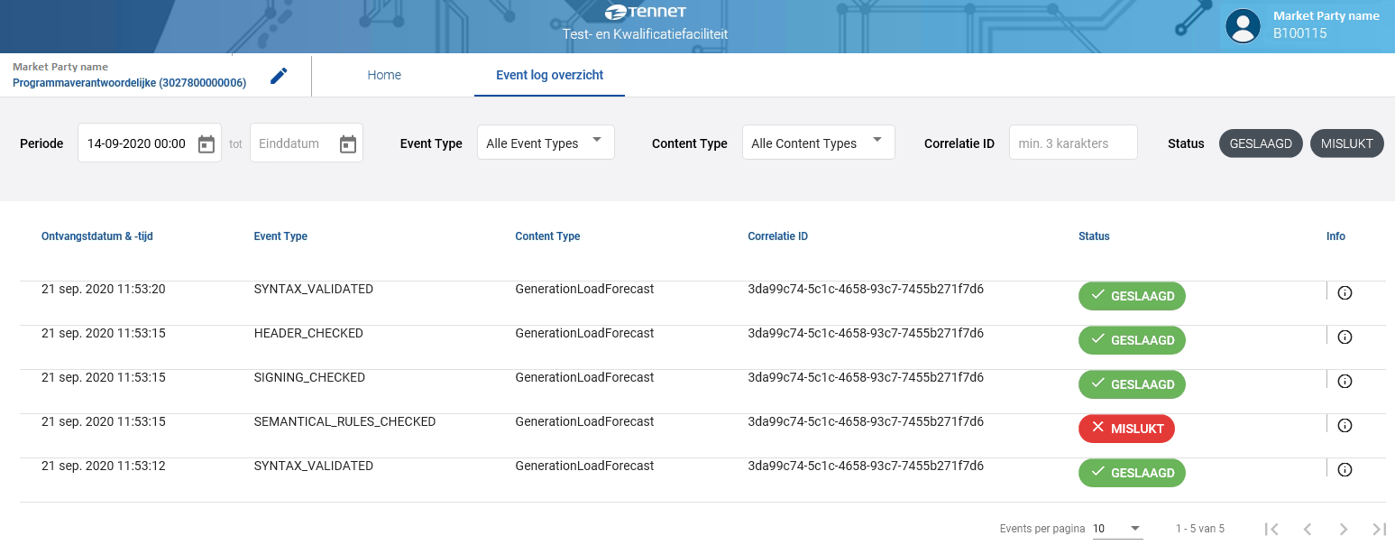
Execute first test and check result
Send a message from your backend to TenneT
Of course the first result you can see in the soap response of the MMC-Hub in your own backend
When the connection is working you also can see the syntax
test result in TQF (visible in the TQF front-end)
Filtering of events to focus on specific messages, events or outcome.
Detail information is supplied
Messages will be downloadable
Notes:
First step is connectivity testing, you can see the results of your tests via MyTenneT
Second step is functional testing, which is specific for each Market Document. Also here results are available via MyTenneT

Slide 23
When first connection was successfull
Execute all tests aligned with the TenneT’s qualification team

Slide 24
Connection & syntax test ends when
For all required message types the test has been executed successfully
The TenneT “test and transition team” ( allocatie2@tennet.eu) has been informed about you are ready with the tests
Test results have been checked and confirmed by the TenneT “test and transition team”

Slide 25

Semantic test
Possible from 1-10-2021 onward

Slide 26
Execute test for semantical test per role
You can execute this test autonomously
Check results in TQF
Gentle reminder: please note TQF expects the TestRequest element in the EDSN header to be filled with the receiving party role {RNB, LNB-E, LNB-G, PV, MV}
Questions: mail to allocatie2@tennet.eu

Slide 27

Qualification possible from 1-10-2021

Slide 28
On Qualification
Qualification tests are run on TQF
Required tests are specified in TenneT Qualification plan (on MijnNedu/TR2021/Test)
For support email: allocatie2@tennet.eu
Qualification can be done during oktober and november 2021
For all required message types the qualification testscripts have to be executed successfully
Test results have to be sent to the TenneT test and transition team at allocatie2@tennet.eu using the template which is attached to the TenneT Qualification plan.
Test results will be checked by the TenneT test and transition team

Slide 29

NEDU GAT

Slide 30
Organisation and Environment
NEDU will organise the GAT
Tests will be executed with connected systems of all organisation within the testgroup.
On TenneT side the MMC-Hub of the qualification environment will be used (for url see Measurements and Allocation –Technical Guide.xlsx).
In order to connect you need to reconfigure our endpoints and install the tennet certificates for the testenvironment
Certificates for the TQF can be reused for the testenvironment for qualification

Slide 31
Go-live

Slide 32
Production configuration
TenneT will configure you in MMC-Hub production
Market party configures/checks own production environment
  Certificates, firewall-rules, MMC-Hub security certificates for production..
More communication will follow on this topic

Slide 33
Go-live
NEDU will organise the project go-live

