Slide 1

1st Information session TR2021
Programme Allocatie 2.0 Tranche 1
23 March 2021
1

Slide 2
The original version of this presentation is in Dutch. The Dutch version will be leading if discrepancies are encountered after translation.
2

Slide 3

Time | Content
9:30 am | Opening Mirjam van der Horst, Project manager NEDU and chairman SR NEDU
9:35 am | Status Allocatie 2.0 Lammert Gerkes Programme manager Allocatie 2.0 NEDU
10:00 am | Programme Allocatie 2.0 Joris Besseling Chairman Design Authority and Change Authority, chairman IC- WE, TenneT
10:20 am | Entry documentation issues IC248, IC249 George Trienekens Chairman work group Metering data GV, TenneT
10:30 am | Digital Coffee break
10:40 am | Message definitions and service descriptions Jan de Jong Service Design, EDSN
10:50 am | Impact on central system C-ARM Theo Lantink Product Manager for Allocation and Reconciliation
11:00 am | MMC Hub and TenneT qualification Elderik de Witte Project manager TenneT
11:15 am | Programme DSO/EDSN Mark Ruiter and Thijs Lindenkamp Programme managers EDSN
11:25 am | Planning, communication and monitoring Mirjam van der Horst
11:35 am | Request for Change Bram van Straalen
11:40 am | Testing and transition Jorik van Vilsteren Testing and Transition manager, EDSN
11:55 am | Wrap-up
Agenda
3

Slide 4
Status Allocatie 2.0
Lammert Gerkes - programme manager Allocatie 2.0 NEDU
4

Slide 5



Intro: profile-based method and energy transition requires
A2.0
Current profile-based method
  The current allocation method dates from 1998
  The method is based on profiles which are defined by the User Profiles Committee every year
  The method assumes a standard consumption pattern for connections and only takes supply into account
Emergence local production, electrification and greater diversity
  Due to the emergence of local production, electrification and greater diversity, as well as differences in consumption patterns, the current method is becoming increasingly unsuitable
  The User Profiles Committee recommends introducing an alternative allocation method before January 1, 2023 because the current profile-based method is, in fact, no longer effective
  In the meantime, an MCF < 0.5 is no longer exceptional in several grid areas in the Netherlands (whereby twice as much consumption is estimated than was actually needed for the profile connections)
5

Slide 6
Intro: Allocatie 2.0 objectives
Higher quality, shorter, fairer and future-proof
Allocatie 2.0 will improve allocation quality as well as efficiency within the market
    Allocatie 2.0 is fairer and will support the energy transition
Allocatie 2.0 is future-proof
6

Slide 7
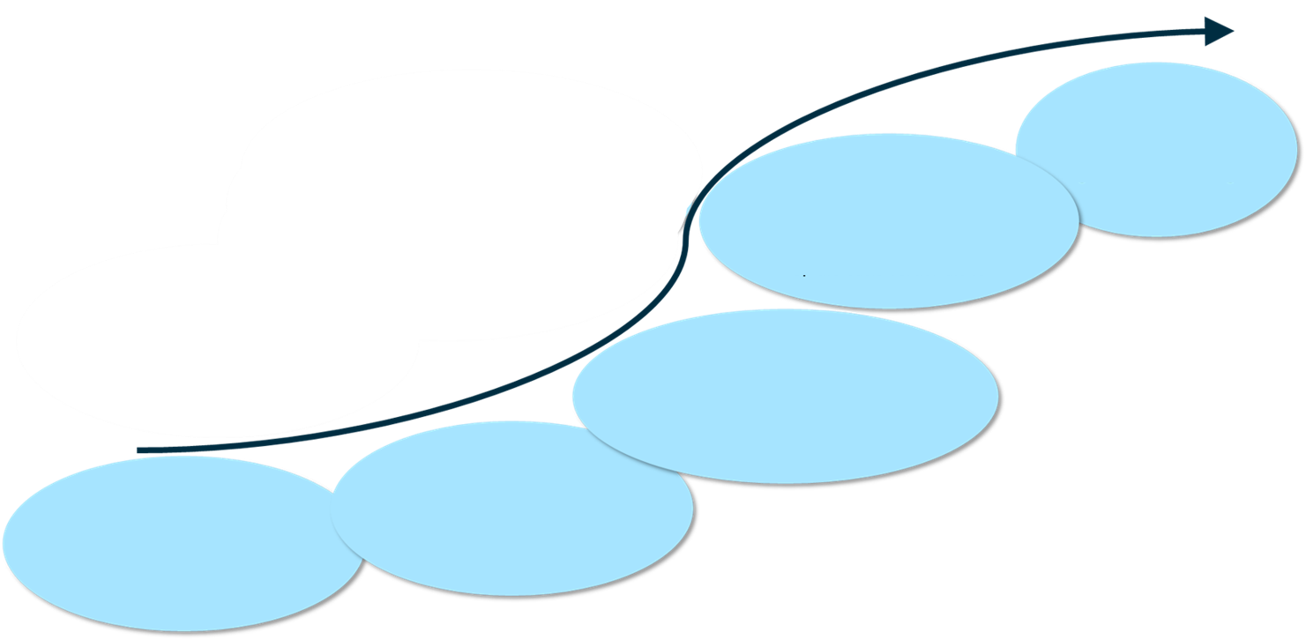
Review Allocatie 2.0
Sector has spent a long time redesigning the allocation process
Revision needed due to delay Energy Act and basis for CSMA
At various moments during the past 5 years, the underlying principles, purpose and need for Allocatie 2.0 were defined in greater detail with major support from the sector
Delays in Energy Act and basis for CSMA
Required interim solution for
profile allocation needed by 1 January 2023
Revision of programme
September 2019
ALV NEDU agrees to conditional phased planning of allocatie 2.0
July 2019
ALV NEDU agrees with the outline proces model and requests the workgroup allocation 2.0 to further elaborate this on that basis
December 2017
Social business case and principles allocation 2.0 aligned in ALV NEDU
start NEDU work group allocatie 2.0
2015
Principles of smart meter allocation laid down in first sketch. Programme Pantheon
2017
Analysis of social business case by a management consulting firm
7

Slide 8
Change of course: Allocatie 2.0
Time constraints due to profile issues
Revision needed due to problems with profile-based method (deviations will become unacceptably high by early 2023)
Regular NEDU approach is unsuitable because:
  Scale of market change is much greater than standard process; this can no longer be classed as a simple change.
  Consequences for iterations with members (more strategic, different stakeholders involved)
  2 central platforms are affected simultaneously: C-ARM and MMC Hub (TenneT). This requires integral programme management
  Multi-release with dependencies
  Extended development time (no longer suitable for standard release process)
  Reliance of legislation and many code changes
  All Market Participants (except GTS) are affected
  Major financial impact (interests/investments) for e.g. BRP’s and grid operators
Therefore: scale of the programme requires:
  Multi-release transition strategy
  More effective control within NEDU (programme structure)
8

Slide 9



Programme design: multi-release transition strategy
Existing NEDU approach
‘Individual’ changes
Legislation
Improvements
Preferences
Issue committees
Sector planning committee
SR NEDU
SR2020
NR2021
Allocatie 2.0 method
Integral A2.0 strategy
Legislation
Improvements
Preferences
DA
Transition strategy
DA
Sector planning
committee
SR NEDU
Tranche 1 - TR2021
Tranche 2
Tranche 3/4
Allocatie 2.0 issues
9

Slide 10
Programme design: stricter governance
Use what works, reinforce wherever necessary
NEDU governance is an effective partnership
Existing NEDU governance + programme layer + cooperation central sub-programmes DSO’s and TSO
Main changes:
  Central decision-making (Sector Steering Committee A2.0)
  Design Authority (DA = ICWE for A2.0 issues/releases)
  Integral design approach with improved focus and availability, a more project-based approach (Issue Project Manager)
  Change Authority (CA = DA in another role after T1 + Release PM + RFC related specialists)
  Integral, adequate processing of RFC’s
  Core Team (cooperation NEDU with central sub-programmes)
  Integral daily cooperation, progress monitoring and control, preparation decision-making.
Release management by SR NEDU is unchanged toward market parties
Client (sponsor)
ALV
Mandated Client
Steering committee Allocatie 2.0 (SSG)
Contractor
Integration Consultation
(SUP, BRP, MRP)
Core Team
(day-to-day management, integration, support)
Programme manager
Product Owner (chairman DA/CA)
Issue Project Manager (DA)
Release Project Manager (SR NEDU)
Sub-programme manager TenneT
Sub-programme manager DSO’s
PMO
Design Authority
(DA)
Sector planning committee
(SPC)
Sector releases NEDU (SR NEDU)
Tranche 1 - TR2021
Tranche 2
Change Authority
(CA)
Tranche 3/4
NEDU entity
Programme entity
10
Notes:
21-04-2021
10

Slide 11
Programme Allocatie 2.0
Joris Besseling - chairman Design Authority and Change Authority, chairman IC-WE, TenneT
11

Slide 12
Allocatie 2.0 objectives: future-proof re-design for how electricity volumes are allocated
Allocatie 2.0 will improve allocation quality as well as efficiency within the market
Allocatie 2.0 is fairer and will support the energy transition
Allocatie 2.0 is future-proof
      Ensures a future where all connections will eventually be metered quarterly
      Also functions if not all smart metres are read
Better match between supply and demand in the electricity market, by allocating actual volumes based on quarterly values and phasing out profile-based method |  | Reduces balancing costs and production costs
Reduction in time and reconciliation volumes; calculation based on more representative prices |  | Reduces financial risks and reconciliation costs
‘User pays’ due to clearer allocation Matching wholesale and retail per quarter |  | No more socialisation of consumption costs and value of input, like currently with profiles Incentives to develop new products Reduces barriers for using flexibility
12

Slide 13
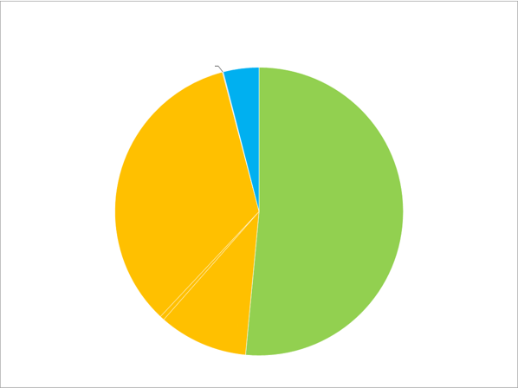
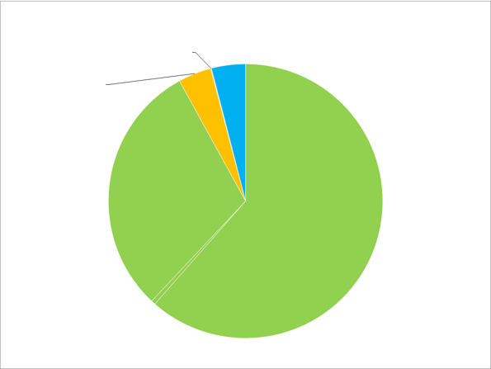
In 2 steps towards allocation based on actual quarterly values wherever possible
Step 1: temporary alternative solution for profile-based connections
Still no explicit basis for CSMA in the current Energy Act, but profiles must be replaced
Temporary alternative solution for profile-based connections: allocation using dynamic profiles which are
determined every day based on quarterly values from representative sample of smart metres
Step 2: CSMA
As soon as basis for CSMA is included in Energy Act
Current situation: To be allocated volumes (arbitrary volumes)
Allocatie 2.0 To be allocated volumes (arbitrary volumes)
KV Unmetered connections
Grid loss
KV Unmetered connections
Grid loss
KV Residual consumption
KV Profile
KV cSMA
Major consumer
Major consumer
Art. 1 para. 2 and 3
GV profiles
Art. 1 para. 2 and 3
13

Slide 14
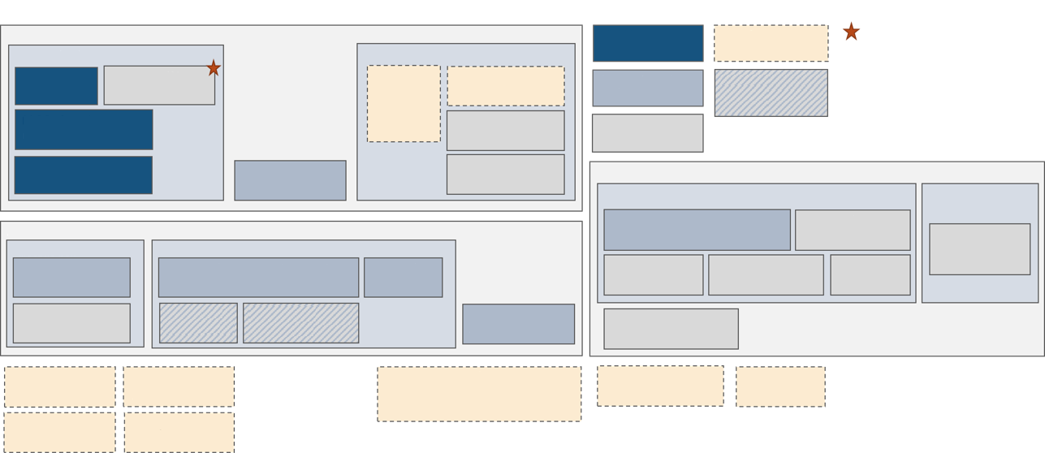
Scope Allocatie 2.0
Core elements Allocatie 2.0 programme
  Exchange metering data major consumers
  Allocation, namely smart metre allocation, and replacement current profile-based method
  Reconciliation/settlement
Legend
Metering data collecton and distribution
TR 2021
Out of scope Allocatie 2.0
Allocatie 2.0 scope t.b.d.
Major consumer
Minor consumer
¹Technical design release 2
Modification allocation backlog
M.1
Metering data GV
Revision SUP (TBD)
Distributon metering data smart meters iSMA
Recording frequency KV not SMA
Scope release 2
Will be modified in several releases, incl. release 2
M.2 Revision metering values telemetric
M.5 SMA repair method
Later releases
M.3 Send metering values daily
M.4 Metering correcton report 2.0
M.6 Optimisation metering chain KV
Reconcilliation/settlement and corrections
Within settlement period
After settlement period
Allocation
RSC.1 Settlement volume differences smart meter allocation
RSC.2 Settlement GV telemetric
RSC.3
Meteriing errors GV correction process
Allocation metered
Allocation not metered
RSC.4 Settlement profile GV & KV
RSC.5 Settlement DIM allocation points
Settlement grid loss
A.1 Allocation GV telemetric & KV SMA
A.2 Necessary interim solution allocation profile-based connections
A.3 Determination SJI/SJA
A.6 Allocation cSMA
A.4 Allocation grid loss¹
A.5 Residual volume configuration
A.7 XML messages Allocation
RSC.6 XML-berichten Reconciliatie/Settlement
Transport price billing
Transport forecast
Initial determination SJI/SJA
SJA/SJA determination unknown readings
Autonomous SJI/SJA supply
Imbalance determination and imbalance billing
KV correction
CERTIQ
Customer processes
14

Slide 15
Allocatie 2.0 will be implemented in several releases
TR2021 - Definitive
IC 249 - exchange metering data GV
IC 248 - revision metering data
Introduction xml metering data GV
TRANCHE 2
Temporary solution allocaton profile
Allocation GV
Introduction xml allocaton
Settlement SMA
Metering correction report
1 release, immediately after TR2021
T0: planned 26 May 2021
Go live: provisional planning Q1 2023
FB1
Settlement issues
Introduction XML settlement
Metering errors GV correction process
SMA repair
Provisional introduction strategy compiled (not yet finalised)
Revise final release layout during T moments
Planning and release layout greatly determined by introduction Energy Act and basis for CSMA
FB2
Allocation grid loss
Residual volume configuraton
FB3
cSMA
Optimisatione metering chain KV
15
15

Slide 16
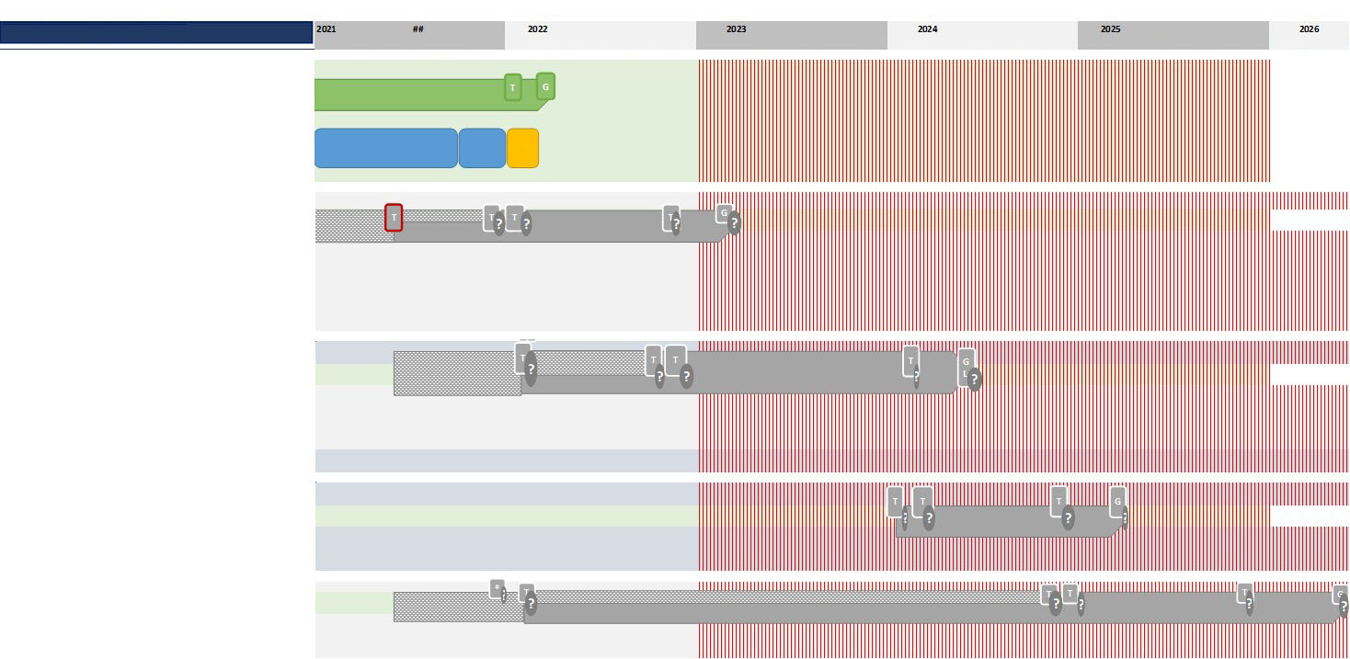
Allocatie 2.0 will be implemented in several releases
1. Milestone planning A2.0
Jan Feb Mar Apr May Jun Jul Aug Sep Oct Nov Dec
Jan Feb Mar Apr May Jun Jul Aug Sep Oct Nov Dec
Jan Feb Mar Apr May Jun Jul Aug Sep Oct Nov Dec
Jan Feb Mar Apr May Jun Jul Aug Sep Oct Nov Dec
Jan Feb Mar Apr May Jun Jul Aug Sep Oct Nov Dec
Jan Feb Mar Apr May
TR2021 - Definitive
IC 249 - exchange metering data GV
IC 248 - revision metering data
Introduction xml metering data GV
Construction
System test
Acceptance test
TRANCHE 2
Temporary solution allocaton profile
Allocation GV
Introduction xml allocaton
Settlement SMA
Metering correction report
FB1
Settlement issues
Introduction XML settlement
Metering errors GV correction process
SMA repair
FB2
Allocation grid loss
Residual volume configuraton
16
FB3
cSMA
Optimisatione metering chain KV
16

Slide 17
Entry documentation issues IC248 and IC249
George Trienekens - chairman work group Metering data GV, TenneT
17

Slide 18
Basis for our work
Firstly, we will use IC248 and IC249 to compile structured functional specifications (= Business Requirements)
These business requirements can be used to specify the implemented processes and message formats
‘Gaps’ in the functional descriptions for issues were returned to the group, who listed the issues for further explanation or specification
18
Notes:
18

Slide 19
Important principle: uses standards as foundation
The European Union will be introduction regulations to promote interoperability in the European energy sector (E and G), without making 1 particular standard compulsory.
Based on what we currently know, the approach will be as follows:
  Role-based model (e.g. harmonised role-based model): this will allow us to take advantage of (cost-related) benefits of harmonisation, without immediately having to concede all national differences
  Reference information/data model (e.g. IEC CIM): use 1 ‘..common reference information model..’ to use the same definitions wherever possible for all national differences
  Reference core process model (e.g. ebIX model): a shared ‘..core process model..’ offers a shared foundation as well as the possibility of national differences wherever appropriate. This means harmonisation can take place step-by-step over a longer period of time
  Reference NL-specific
19
Notes:
19

Slide 20
Input: IC’s and standards
Towards 1 European energy market in order to improve general prosperity in Europe
This requires process harmonisation and information exchange
IEC – CIM (Common Information Model)
The Harmonized Electricity Market Role Model
eBix – Core Process Model
Specific to NL market model
IC249
Work group
Metering data GV XML
Business requirements
Technical message specifications
IC248
20
Notes:
20

Slide 21
Output: business requirements
UseCase diagram: shows clusters of processes/sub-processes
Activity diagram: shows modelled specifications for a process as content of a Use Case
Class diagram: provides a description for exchanged information
Partner diagram: shows the relevant roles
Finally, we will add a suitable definition (meaning) to each of the above-mentioned elements
Finally: a brief review of the process
21
Notes:
21

Slide 22
Message definitions and service descriptions
Jan de Jong - Service Design, EDSN
22

Slide 23
Starting points for message definitions and service descriptions TR2021
Information to be exchanged: Class diagrams BRS
Message definitions: Ontwerpkeuzes NEDU/EDSN (in Dutch)
Reference models: IEC CIM/ENTSO-E CIM
MMC Hub: TenneT Web Services guide
MMC Hub: Technical Guide - Measurements & Allocations Documents
23

Slide 24
Information to be exchanged
Metering data time series for allocation points/usage points/transfer points/connection points
Volumes production installations
Volumes and metre readings for allocation points/usage points/transfer points/connection points
Revision requests after checks on metering data
Revision requests after checks on allocation data
24

Slide 25
Information to be exchanged
Metering data time series for allocation points/usage points/transfer points/connection points
Volumes production installations
Volumes and metre readings for allocation points/usage points/transfer points/connection points
Revision requests after checks on metering data
Revision requests after checks on allocation data
25

Slide 26
Information to be exchanged
Metering data time series for allocation points/usage points/transfer points/connection points
Volumes production installations
Volumes and metre readings for allocation points/usage points/transfer points/connection points
Revision requests after checks on metering data
Revision requests after checks on allocation data
Only for SO
changes
26

Slide 27
Information to be exchanged
Metering data time series for allocation points/usage points/transfer points/connection points
Volumes production installations
Volumes and metre readings for allocation points/usage points/transfer points/connection points
Revision requests after checks on metering data
Revision requests after checks on allocation data
For BRP and SO
max. volumes
27

Slide 28
Information to be exchanged
Metering data time series for allocation points/usage points/transfer points/connection points
Volumes production installations
Volumes and metre readings for allocation points/usage points/transfer points/connection points
Revision requests after checks on metering data
Revision requests after checks on allocation data
Orig. volume
Proposed volume
28

Slide 29
Information to be exchanged
Metering data time series for allocation points/usage points/transfer points/connection points
Volumes production installations
Volumes and metre readings for allocation points/usage points/transfer points/connection points
Revision requests after checks on metering data
Revision requests after checks on allocation data
Only reference
29

Slide 30
Business Services for TR2021
Information to be exchanged | Service
1. Metering data time series | BSCMF0061 - Uitwisselen meetgegevens tijdseries (in Dutch)
2. Volumes production installations | BSCMF0062 - Uitwisselen meetgegevens volumes installatie (in Dutch)
3. Volumes and metre readings | BSCMF0063 - Uitwisselen meetgegevens volumes en meterstanden (in Dutch)
4. Revision requests after checks on metering data | BSCMF0064 - Uitwisselen herzieningsverzoek na controle meetgegevens (in Dutch)
5. Revision requests after checks on allocation data | BSCMF0065 - Uitwisselen herzieningsverzoek na controle allocatiegegevens (in Dutch)
30

Slide 31
Business Services for TR2021
BSCMF0061 - Uitwisselen meetgegevens tijdseries (in Dutch)
  Time series over 1 day or over 1 month
  MRP sends time series to SO and BRP
  Time series per product type/energy direction
  Time series over 1 day for:
    Allocation point electricity major consumer
    Grid-to-grid transfer point electricity
    Allocation point system balance electricity
    Transfer point MWNET electricity
  Time series over 1 month for:
    Allocation point electricity major consumer
    Grid-to-grid transfer point electricity
    Usage point gas major consumer
    Connection point for distribution grids gas
31

Slide 32
Business Services for TR2021
BSCMF0062 - Uitwisselen meetgegevens volumes installatie (in Dutch)
  Volumes over a period equal to or longer than 1 calendar year and shorter or equal to 1 calendar month
  MRP sends volumes to SO
  Volumes for all installations ‘behind’ the allocation point
  Per installation i.e.: identification, volume, energy direction, period
  Volumes installation over a period for:
    Allocation point electricity profile major consumer
    Allocation point electricity telemetrics major consumer
32

Slide 33
Business Services for TR2021
BSCMF0063 - Uitwisselen meetgegevens volumes en meterstanden (in Dutch)
  Volumes and metre readings over a period equal to or longer than 1 calendar year and shorter or equal to 1 calendar month
  MRP sends volumes and metre readings to SO and BRP
  Per usage point i.e.: volume, tariff zone, energy direction
  Per register i.e.: identification, tariff zone, energy direction, metre reading
  For NB: residual volume gas, peak load gas, weekly peak load elec., monthly peak load elec.
  Volumes and metre readings over a period for:
    Allocation point electricity profile major consumer
    Allocation point electricity telemetrics major consumer
    Transfer point electricity major consumer MLOEA
    Usage point gas major consumer
    Connection point distribution grids gas
    Grid-to-grid transfer point electricity
33

Slide 34
Business Services for TR2021
BSCMF0064 - Uitwisselen herzieningsverzoek na controle meetgegevens (in Dutch)
  Revision requests for objections about metering data in daily messages from tele-metered allocation points
  SO and BRP send revision requests to MRP
  Various reasons for submitting revision request:
    BRP/SO: metering data expected but not yet received (do not send metering data)
    BRP: estimated metering data too long (send original and proposed metering data)
    SO: metering data not compatible with the delivery direction (do not send metering data)
    SO: metering data not compatible with the registered capacity (send original metering data)
    BRP: metering data contested (send original and proposed metering data)
    BRP: zero values measured longer than 7 calendar days (send original and proposed measurement data)
  BRP/SO initially receive confirmation or rejection of the revision request from MRP
  If confirmation is received, a second step will take place where MRP evaluates the revision request
  Once the revision request has been sent, the MRP sends a response to say whether the revision request has or has not been carried out
  If it is carried out, the MRP sends the corrected metering data
34

Slide 35
Business Services for TR2021
BSCMF0065 - Uitwisselen herzieningsverzoek na controle allocatiegegevens (in Dutch)
  Revision requests for objections about allocation data
  BRP sends revision requests to SO
  Various reasons for submitting revision request:
    BRP: allocation data allocation point received but not expected
    BRP: allocation data allocation point expected but not received
  BRP initially receives confirmation or rejection of the revision request from the SO
  If confirmation is received, a second step will take place where SO evaluates the revision request
  Once the revision request has been sent, the SO sends a response to say whether the revision request has or has not been carried out
  If it is carried out, the SO sends the corrected allocation data
35

Slide 36
Versions service messages TR2021 (in Dutch)
BSCMF0061 - Uitwisselen meetgegevens tijdseries
  Business Service Uitwisselen meetgegevens tijdseries v4.0
BSCMF0062 - Uitwisselen meetgegevens volumes installatie
  Business Service Uitwisselen meetgegevens volumes installatie v2.0
BSCMF0063 - Uitwisselen meetgegevens volumes en meterstanden
  Business Service Uitwisselen meetgegevens volumes en meterstanden v2.0
BSCMF0064 - Uitwisselen herzieningsverzoek na controle meetgegevens
BSCMF0065 - Uitwisselen herzieningsverzoek na controle allocatiegegevens
  Business Service Uitwisselen herzieningsverzoeken v2.0
Sample messages for above-mentioned service descriptions are currently being compiled and will be available as of April 2021!
36

Slide 37
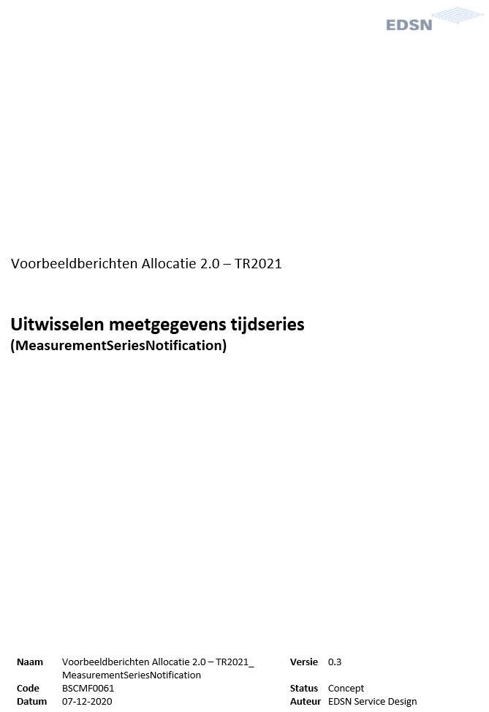




Service descriptions TR2021

Slide 38
Impact on central systems C-ARM
Theo Lantink - Product Manager for Allocation and Reconciliation
38

Slide 39
IC231 ‘Send metering data daily’
DSO sends, also on non-working days (read: weekend and public holidays), allocation results (electricity) to TenneT and BRP for the previous calendar days (E31 and MSCONS)
This process is fully automated (without manual validations)
Allocation results will also be sent for MCFs outside the regular bandwidths
The 'formal' N-1 allocation is carried out on the next working day (as is)
39

Slide 40
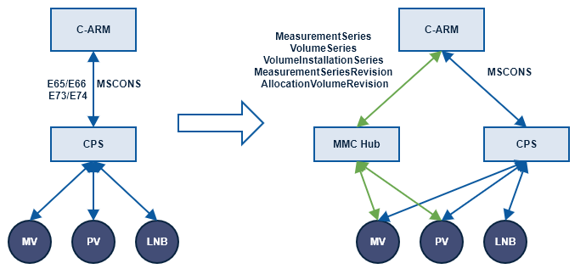
IC248/IC249 Communication
Communication via MMC Hub instead of CPS
40

Slide 41
IC248 ‘Objections telemetric metering data’ - DSO → MRP
Revision request after checks on metering data
Messages in accordance with BS Exchange revision request
Potential reasons for objection:
  Meetgegevens verwacht maar niet ontvangen
  Meetgegevens passen niet bij de leveringsrichting
  Meetgegevens passen niet bij de geregistreerde capaciteit
In dual phase (XML/Edine):
  Only Measurement Series Revision (XML) is used
  DSO no longer automatically initiates an E73 for MRP. However, DSO can decide to manually send an E73 using C-ARM.
  DSO still sends E73 after receiving E74
41

Slide 42
IC248 ‘Objections telemetric metering data’ - BRP → DSO
Revision request after checks on allocation data
Messages in accordance with BS Exchange revision request
Potential reasons for objection:
  Allocation data allocation point received but not expected
  Allocation data allocation point expected but not received
Revision request is no longer sent to MRP. BRP sends them directly to MRP
In dual phase (XML/Edine):
  E74 is still processed and/or sent
  E74 is always sent via E73
  When sending E73, a check is not carried out to see if MRP has already switched to XML
42

Slide 43
IC249 ‘Metering data GV’ - MDT (Metering Data Telemetry)
Messages in accordance with BS Exchange metering data time series
Checks and follow-up of checks (error message) based on checks in Business Service description
Various times series (input/acquisition) are stored separately
Acquisition and input are still settled in the allocation
Statuses:
  ELK: no longer sends statuses to the BRP via the MSCONS 99E (Edine), which it has received from MRP from the XML message described in IC249. The fields that are currently filled in are left empty. The only status that DSO still sends is if the data has been repaired in accordance with IC249. In this case, the field for the concerned imbalance settlement period(s) will feature the status E08 ‘Estimated by Netbeheerder’
GAS: For BALL messages, status mapping will take place using the IC249 message (as agreed upon in the IC-WG)
43

Slide 44
IC249 ‘Metering data GV’ - MDP (Metering Data Periodic) GV Metering data
Messages in accordance with BS Exchange metering data volumes and metre readings
Checks and follow-up of checks (error message) based on checks in Business Service description
  Incl. check for physical capacity
  Incl. check for BRP Switch (RFC 249.1)
C-ARM expects every (XML) message to contain a fully data set for consumption. This set overwrites the previously supplied consumption set for the same consumption period (no partial deliveries)
MLOEA in accordance with current functions and IC270
(Separate message for PAP, SAP and VAP)
44

Slide 45
IC249 ‘Metering data GV’ – MDP GV Production installations
Separate message besides message for supplying metering data (in contrast with E65)
Messages in accordance with BS Exchange metering data volumes installation
Checks and follow-up of checks (error message) based on checks in Business Service description
Volumes are, in accordance with current process, also supplied to CertiQ together with metering data
C-ARM expects every (XML) message to contain a fully data set for consumption. This set overwrites the previously supplied consumption set for the same consumption period (no partial deliveries).
45

Slide 46
MMC Hub and TenneT qualification
Elderik de Witte - project manager TenneT
46

Slide 47
Process and message quality safeguards performance electricity market
Every day, the MRP, SUP, BRP, DSO, FNB, BSP and TSO make sure that the electricity market functions properly and the grid remains stable
This release (Allocatie 2.0 Tranche 1) has an impact on messages between market parties
NEDU and TenneT will be organising a whole series of tests to make sure that the sender and recipient interpret the message content (and process) in the same way
TenneT is doing this in its role as qualifying organisation for these market processes
47

Slide 48
Test series: qualification
Tennet delivery test approach:
  Construction and test market party internal
  Assembly and connection tests on MMC Hub in a sandbox environment (TQF)
  Functional tests for market messages in sandbox environment (TQF)
  Qualification tests in an environment with connected systems. This involves chain tests with several market roles in groups, as normal with NEDU releases
Test phase
Qualification phase
Connectivity testing
Functional testing
Executing qualification scenarios
48

Slide 49
Planning
49

Slide 50
Documentation and contact possibilities
Documentation about connecting to the MMC Hub can be found at:
  MyTenneT under IT connections, MMC Hub/Documentation (as of 1 April 2021)
Documentation about qualification will be available on MyTenneT in Q2
Questions about MMC Hub or qualification? Contact via allocatie2@tennet.eu
Will Tennet be providing other information sessions with more detailed information?
  Yes (monthly as of Q3)
50

Slide 51
FAQ
Are there any sample messages which I can use for my internal testing?
  Yes. They are currently being compiled and will be supplied later, either at NEDU or on MyTenneT
Is it possible to start connection tests and semantic tests any sooner?
  If possible, we will try to support this. Related communication will follow later this year.
Are the tests voluntary or compulsory?
  Function tests and qualification tests are part of a set of compulsory tests. The qualification matrix describes which tests must be carried out by each type of party. Qualification document will be available on MyTenneT in Q2
As an MRP, must I qualify for everything or only for (sub) message types that I use for operational purposes?
  Only message types you use for operational purposes. Consult with TenneT about this prior to the qualification
51

Slide 52
Questions?
52

Slide 53
Programme DSO/EDSN
Mark Ruiter and Thijs Lindenkamp - programme managers EDSN
53

Slide 54
Governance central programme
Governance by DSO’s is arranged via a Programme Organisation Management (pRO) for Allocatie 2.0, which includes central IT delivery at EDSN
NEDU programme Allocatie 2.0
Sub-programme DSO Allocatie 2.0
NEDU General Meeting of Members
(Sponsor group)
Council of Grid operators Netherlands
(Sponsor group)
Domain council Customer & Market
(Client)
SSG NEDU
(Mandated client)
Programme council
(SRO and BO’s: mandated client)
Product Owner
Programme manager
Expert Team
(Knowledge position)
Programme Organisation Management
(Contractor)
Business Change Authority
Release project managers
TenneT programme manager
DSO programme manager
Tranche 1
(EDSN & DSO’s)
Tranche 2
(EDSN & DSO’s)
Tranche X
(EDSN & DSO’s)
Core Team
EDSN
DSO
DSO
Executive Programme
DSO
54

Slide 55


High Level Planning - IT Delivery
The EDSN IT Programme delivery-organisation has been set up to realise the agreed planning, and performs the central IT activities and offers support with operational management when developing Allocatie 2.0 Tranche 1.
Codification
User acceptance
Specifications
Transition
T0
T1
T1
Go
Live
T2
Go
Live
Initiation
Design, construction and testing
Deployment
(Transition & go live)
After care
Management
01/05/2020
01/07/2020
01/07/2020
03/01/2022
GAT
19/03/2022
08-2020
Start Construction MDP
31-09-2021
End Realisation
09-2020
Start Construction MDT
16/08/2021
DSO Acceptance
08/06/2020
Start Refinement
55

Slide 56
Cooperation
EDSN and pRO coordinate very closely about priorities, scope, planning and deliverables. Teams work together when resolving issues and identifying risks
IT Delivery construction teams use an agile approach, where scrum teams are responsible for refinement, construction and functional tests on various Epics and Features
Scope and time are fixed, namely for issue that are part of Theme release 2021
The approach used by the various market parties in the sector features T moments in the planning and clear phase transitions between design, construction, test and go live. Central construction activities by EDSN have already started
pRO is managing the market parties on behalf of the DSO’s (NEDU User acceptance test and transition via regular management)
The success of the programme will be partly determined by the coordination between EDSN and pRO, on the one hand, and all market parties on the other
56

Slide 57
Planning, communication and monitoring
Mirjam van der Horst - project manager NEDU and chairman SR NEDU
57

Slide 58
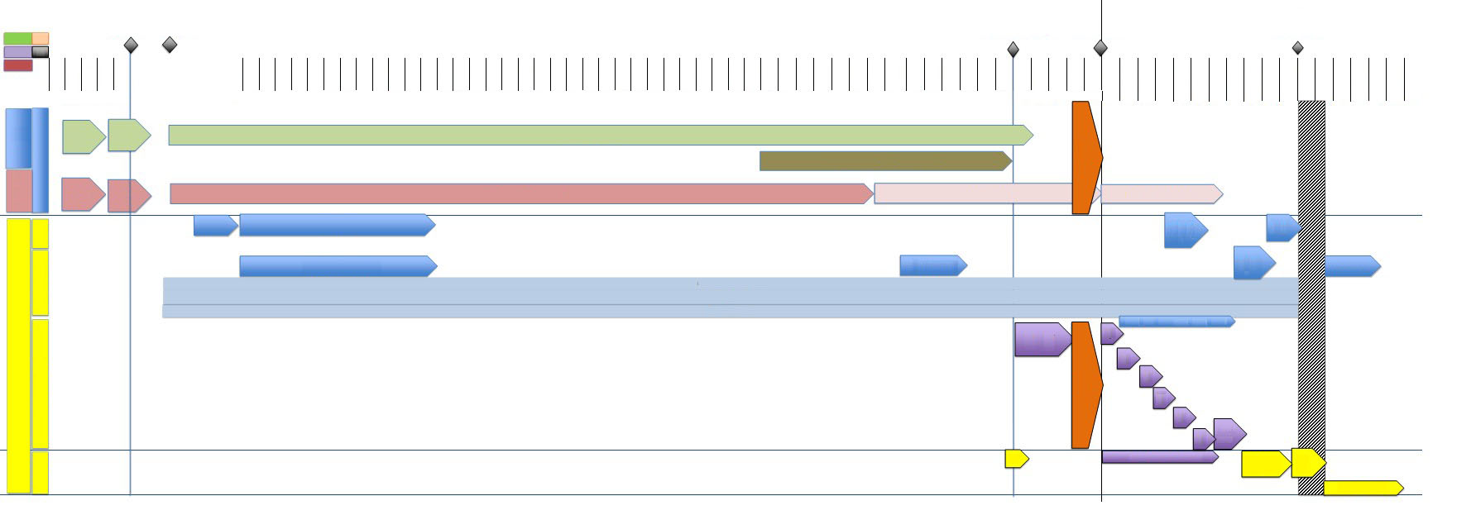
Planning (also see mijnNEDU)
T1
1 July 2020
T1'
30 Sept 2020
T2'
29 November 2021
T2
3 January 2022
Go Live
19 March 2022
FAT-N
PR
ACT
PR
OPT
1 Jun
8 Jun
15 Jun
22 Jun
29 Jun
Aug
Sept
Oct
Nov
Dec
4 Jan
11 Jan
18 Jan
25 Jan
1 Feb
8 Feb
15 Feb
22 Feb
1 Mar
8 Mar
15 Mar
22 Mar
29 Mar
5 Apr
12 Apr
19 Apr
26 Apr
3 May
10 May
17 May
24 May
31 May
7 Jun
14 Jun
21 Jun
28 Jun
5 Jul
12 Jul
19 Jul
26 Jul
2 Aug
9 Aug
16 Aug
23 Aug
30 Aug
6 Sep
13 Sep
20 Sep
27 Sep
4 Oct
11 Oct
18 Oct
25 Oct
1 Nov
8 Nov
15 Nov
22 Nov
29 Nov
6 Dec
13 Dec
20 Dec
27 Dec
3 Jan
10 Jan
17 Jan
24 Jan
31 Jan
7 Feb
14 Feb
21 Feb
28 Feb
7 Feb
14 Mar
21 Mar
28 Mar
4 Apr
11 Apr
18 Apr
25 Apr
2 May
wk23
wk24
wk25
wk26
wk27
Jul
wk 1
wk 2
wk 3
wk 4
wk 5
wk 6
wk 7
wk 8
wk 9
wk 10
wk 11
wk 12
wk 13
wk 14
wk 15
wk 16
wk 17
wk 18
wk 19
wk 20
wk 21
wk 22
wk 23
wk 24
wk 25
wk 26
wk 27
wk 28
wk 29
wk 30
wk 31
wk 32
wk 33
wk34
wk35
wk36
wk37
wk38
wk39
wk40
wk41
wk42
wk43
wk44
wk45
wk46
wk47
wk48
wk49
wk50
wk51
wk52
wk1
wk2
wk3
wk4
wk4
wk4
wk4
wk4
wk4
wk4
wk4
wk4
wk4
wk4
wk4
wk4
wk4
wk4
Development C-AR/C-
Business Needs
CMF
Impact Analysis
Construction and Internal Tests
Christmas recess
TENNET
Integration tests and Chain tests
Impact Analysis
Business Needs
Construction and Internal Tests
pre-qualificatione
qualification MMC-hub
Market
request
request
Market readiness GO Live
Go Deployment SR NEDU
Communication
Info meeting 1
-Info meeting
ALV Go Live
Evaluation
Two-weekly newsletter
Sharepoint
FAQ & Mailbox
Market readiness complete GAT
NEDU
FAT Lead group
GAT
Acceptance test
GAT
Christmas recess
GAT
GAT
GAT
overrun
Vrije Test Marktpartijen
GAT
Transition
DR
Preparation Go Live
Go Live
GoLive Aftercare
58

Slide 59
Planning
Important dates 2021
October 2021: connection tests with MMC Hub
October 2021: information session tests and transition
29 November 2021: start Functional acceptance test/Lead group tests
Important dates 2022
3 January 2022: start User acceptance tests
11 February 2022: end User acceptance tests
14 February 2022: send market readiness go live
09 March 2022: NEDU General Meeting of Members decision to go live
9-18 March 2022: freeze on systems
18 March 2022: SR NEDU/SSG start deployment
19 March 2022: go live
59

Slide 60
Communication channels
Information session releases in autumn 2021
mijnNEDU: documents and Q&A
Newsletter NEDU Releases (www.nedu.nl/nieuws/abonneer)
Via SSG, Steering committee Releases and NEDU General Meeting of Members, work groups, Lead group Tests, Consultation group Transition.
Questions about this release can be asked by sending an e-mail to: allocatie2.0@edsn.nl
60

Slide 61
mijnNEDU
Everyone has access: mijnnedu@nedu.nl
mijnNEDU/releases/theme release
Theme Release 2021 - Introduction page (sharepoint.com)
Issues, BRS, MSP
Message definitions & Business Services
RFC’s
Project management
Tests
Transitions
Information
61

Slide 62
Monitoring via market readiness
Market readiness takes place via SurveyMonkey (spambox?)
First request: request project manager and test manager (low response)
Members: we continue to see a member of NEDU General Meeting of Members as project manager/first contact person in case of no response
Non-members: we will also keep a list of this (contact person list)
BRP-E: reminder to respond sent by TenneT
After the information phase, monitoring will start for progress in construction, internal testing, questions entry documentation and RFC’s
62

Slide 63
Requests for Change
Bram van Straalen – DSO expert, member Work group XML Messages, member SR NEDU
63

Slide 64
RFC’s - overview
Contents
  RFC TR2021.1 BRS update from version 1.0 to 2.0
  RFC TR2021.3 Modification BD Measurement Series Acknowledgement
  RFC TR2021.4 BRS update from version 2.0 to 3.0
  RFC 249.1 RFC 249.1 Separate consumptions after switch of BRP
  RFC 249.2 Mapping XML Metering values telemetric with MSCONS 99E
  RFC 249.3 Mapping status codes from XML Metering values telemetric to BALL
  RFC 231.1 Manual actions DSO on non-working days
Scope
  RFC TR2021.2 Expand scope to include IC259
  RFC Scope change TR2021 due to IC270
64

Slide 65
RFC’s - contents (1)
1-7-2020 BRS Metering data GV & Revisions Metering data GV 1.0 (initial version with a few open points)
7-8-2020 BS Time series 1.0 + BD Measurement Series 1.0 (initial version)
21-8-2020 BS Time series 2.0 + BD Measurement Series 2.0 with the following changes:
  Expansion number of use cases in the BRS
  Number and usage decimals for volume
  Modification validation rules
2-10-2020 RFC TR2021.1 BRS update from version 1.0 to 2.0
  Solution for open points in BRS version 1.0
  Addition use cases (for the TSO)
  Various minor modifications
2-10-2020 BRS Metering data GV & Revisions Metering data version 2.0
2-10-2020 BS Volumes and metre readings 1.0 + BD Volume Series 1.0
2-10-2020 BS Volumes installation 1.0 + BD Volume Installation Series 1.0
65

Slide 66
RFC’s - contents (2)
11-11-2020 BS Revision requests 1.0 + BD Measurement Series Revision 1.0 + BD Allocation Volume Revision 1.0
11-11-2020 RFC TR2021.3 Modification BD Measurement Series Acknowledgement
  Removal unnecessary parts of the Acknowledgement message
11-11-2020 BD Measurement Series Acknowledgement 3.0
11-11-2020 BS Time series 3.0 with the following changes:
  Supply volumes in whole numbers (without decimals)
  Modification of a few validation rules
16-12-2020 RFC TR2021.4 BRS update from version 2.0 to 3.0
  New use case A20.036 added for metering data TSO
  New use case UC A20.010 added for MWNET
  Use cases A20.010, A20.101, A20.111, A20.112, A20.121 and A20.131 modified
  Information exchange revision requests modified: first confirmation/rejection correctly received followed by response about whether or not revision request processed
  Table added with status of metering data and revision possibilities (table from IC248)
16-12-2020 BRS Metering data GV & Objections Metering data version 3.0
66

Slide 67
RFC’s - contents (3)
20-1-2021 RFC 249.1 Separate consumptions after switch of BRP
  For BRP switch, MRP also supplies split consumptions to SO
  Impact on code change proposal, BRS and BS Volumes and metre readings
20/01/2021 RFC 249.2 Mapping XML Metering values telemetry with MSCONS 99E
  Validation statuses in MSCONS 99E are left empty
  Exception for metering data repaired by grid operator
10/02/2021 RFC 249.3 Mapping status codes from XML Metering values telemetric to BALL
  The mapping table contains mapping for validation statuses in the BALL message
03/03/2021 RFC 231.1 Manual actions DSO on non-working days
  Clarified that the DSO need not perform manual actions on non-working days
67

Slide 68
RFC’s - contents (4)
3-3-2021 BS Time series 4.0 with the following changes:
  Modification of a few validation rules
  3-3-2021 BS Volumes and metre readings 2.0 with the following changes:
  Modification XML code product type
  Modification of a few validation rules
3-3-2021 BS Volumes installation 2.0 with the following changes:
  Modification XML code product type
  Limitation XML codes energy direction
  Modification of a few validation rules
3-3-2021 BS Revision requests 2.0 with the following changes:
  Modification XML code product type
68

Slide 69
RFC’s - scope
11-11-2020 RFC TR2021.2 Expansion scope to include IC259
  IC259 Registration MRP on S-AP (MLOEA)
  New release date for IC259 on 23-10-2021
10-2-2021 RFC Scope change TR2021 due to IC270
  IC259 Registration MRP on S-AP (MLOEA) out of scope TR2021 and to NR2021
  IC270 EAN code connection point for MLOEA also in NR2021
  This means TR2021 consists of: IC231, IC248 and IC249
69

Slide 70
Testing and transition
Jorik van Vilsteren - Test and Transition manager, EDSN & NEDU
70

Slide 71
Explanation Work package Tests
Notes:
71

Slide 72
TR2021 Allocatie 2.0 Tranche 1 - tests
Lead group (representatives DSO, TSO, MRP, BRP) performs progression and regression test, before releasing for User Acceptance Test (GAT)
Lead groups tests take place from 29/11/2021 – 17/12/2021
GAT has been scheduled for 03/01/2022 – 25/02/2022, followed by 2 weeks overrun/re-resting
Market parties perform GAT and voluntary tests
EDSN provides dedicated support during the GAT
Due to the size of TR2021 Allocatie 2.0 Tranche 1, participating market parties are divided into groups; 2 groups perform parallel tests for 1 week
The findings process will be controlled from within the project TR2021 Allocatie 2.0 Tranche 1 (Test coordinator)
Progress will be monitored within the project TR2021 Allocatie 2.0 Tranche 1 (Test coordinator)
72

Slide 73
Milestones User acceptance test
Group number | Week number | Period
Lead group TR2021 Allocatie 2.0 Tranche 1
Lead group tests | 48, 49, 50 | 29/11/2021 to 17/12/2021
Potential overrun | 51 | 20/12/2021 to 24/12/2021
GAT TR2021 Allocatie 2.0 Tranche 1
Group 1 & 2 | 1 | 03/01/2022 to 07/01/2022
Group 3 & 4 | 2 | 10/01/2022 to 14/01/2022
Group 5 & 6 | 3 | 17/01/2022 to 21/01/2022
Group 7 | 4 | 24/01/2022 to 28/01/2022
Overrun week / re-testing findings | 5, 6, 7, 8 | 31/01/2022 to 11/02/2022
Freeze period | 10, 11 | 09/03/2022 to 18/03/2022
73

Slide 74
Explanation work package transition
Notes:
74

Slide 75
Work package transition
Deliverables:
Transition plan
Fall-back plan
Entry and Exit Criteria
Process agreements
Communication and command structure
Technical roadmap
Operational roadmap
Market readiness (qualification)
75

Slide 76
Fall-back plan
The Fall-back plan contains a description of the possibilities and measures for initiating a different scenario if the go live is unsuccessful
The aim of this document is to establish agreements that will allow the sector to be prepared for the fall-back scenario if the go/no go criteria for the transition are not met
76

Slide 77
Entry and Exit Criteria
The aim of the entry and exit criteria is to establish criteria that must be met before the transition can be started, or criteria that must be met before the transition can be ended
This document makes a distinction between two software deployments:
  Dry run
  Go live
77

Slide 78
Process agreements
The aim of process agreements is to establish, and inform the sector about, alternative and additional sector agreements in relation to the transition
78

Slide 79
Communication and command structure
The communication and command structure describes the communication channels and governance structure prior to and during execution of the dry run and go live for the sector release
There must be absolute clarity about who is entitled to make specific decisions during the project. In addition, the involved parties must clearly know which communication they can expect and how they can contact central coordinators about issues, and how these issues will be dealt with. Furthermore, there must be a clear description about how involved parties can report performed actions to the transition centre
This document makes a distinction between the following processes:
  Communication: the process that arranges information exchange from and to market parties based on the transition roadmap
  Issue process: the issue process is a process that is initiated during the process if there are potential risks for the Transition roadmap, due to both central and local issues
  Decision-making: decision-making process during planned decision-making moments and unplanned issues
79

Slide 80
Roadmaps (Technical + Operational)
The roadmaps for the dry run and go live are compiled in collaboration with the Consultation group
Roadmaps are used to coordinate the intended activities during the dry run and go live window
Progress and coordination will be supported by the project
80

Slide 81
Market readiness
Market parties must qualify for the MMC Hub in relation to TR2021 Allocatie 2.0 Tranche 1 (see presentation Tennet TSO)
Monitoring and reporting progress about qualification requirements
81

Slide 82
Consultation group Transition
Supplier, balance responsible parties, metering responsible parties, national grid operators and regional grid operators will be part of the Consultation group Transition, in order to:
  Be a central consultation for coordination with EDSN
  Test the approach
Agreements will be made with the Consultation group Transition about:
  Content of roadmaps for dry run and go live
  Which channels and file formats will be used when supplying files
  The number, and planning for, bulk and delta transfers
Request to participate in Consultation group Transition immediately after information session March 2021
  It would be ideal if all market roles that are impacted by TR2021 (DSO, TSO, MRP, BRP) are involved in the Consultation group
  Registration is possible until 10 April 2021 via allocatie2.0@edsn.nl
82

Slide 83
Finally, what do we expect of you?
Scan entry documentation
Start construction and testing
Ask questions via: allocatie2.0@edsn.nl
Questions about the hub via: allocatie2@tennet.eu
Supply name project manager/contact person via: projecten@nedu.nl
Read the newsletters (subscribe: www.nedu.nl/nieuws)
Respond to market readiness questions (SurveyMonkey)
Information sheets on mijnNEDU this week
Followed by translation into English
Q&A will follow in a few weeks, after double check
Thank you for your attention, and good luck!
83

