Slide 1

2nd Information session TR2021 - Tranche 1
Programme Allocatie 2.0

Slide 2
The original version of this presentation is in Dutch. The Dutch version will be leading if discrepancies are encountered after translation.
2

Slide 3








Welcome to the 2nd TR2021 information session
Tranche 1 – Programme Allocatie 2.0
Mute your microphone
Turn off your camera
Ask questions via the chat feature. We are working with a moderator.
Presentation on mijnNEDU
The session is being recorded
The session will be available for 4 weeks. E-mail projecten@nedu.nl
Recording is for invitees
Recording will stop after last sheet: Questions section not recorded

Slide 4

Agenda
Current status programme NEDU
Mirjam van der Horst, Vz SR NEDU, secretary SSG
Current status programme DSO (EDSN)
Mark Ruiter, programme manager EDSN
Current status programme TenneT
Elderik de Witte, project manager TenneT
Tests and qualification TenneT-MMC hub
Ivo den Haan, Test manager
Break
Update tests and transition
Jorik van Vilsteren
Implementation strategy per market role
Bram van Straalen, DSO expert
Wrap-up

Slide 5
Current status programme NEDU
Mirjam van der Horst - project manager NEDU, chairman SR NEDU and secretary SSG

Slide 6
Current status TR2021 - Tranche 1 Allocatie 2.0

Slide 7
RFC’s since previous information session (red = new)
Contents
  RFC TR2021.1 ‘BRS update van versie 1.0 naar 2.0’
  RFC TR2021.3 ‘Aanpassing BD MeasurementSeriesAcknowledgement’
  RFC TR2021.4 ‘BRS update van versie 2.0 naar 3.0’
  RFC TR2021.5 ‘Technische validaties Allocatie 2.0 berichtenverkeer’
  RFC 249.1 ‘Splitsen verbruiken bij PV-Switch’
  RFC 249.2 ‘Mapping XML Meetwaarden telemetrie met MSCONS 99E’
  RFC 249.3 ‘Mapping statuscodes van XML Meetwaarden telemetrie naar BALL’
  RFC 249.4 ‘Tijdigheid maandelijkse bericht tijdseries ELK‘
  RFC 249.5 ‘Toevoegen Use-cases LNB-E’
  RFC 231.1 ‘Handmatige acties RNB op niet-werkdagen’
Scope
  RFC TR2021.2 ‘Uitbreiden scope met IC259’
  RFC ‘Scopewijziging TR2021 door IC270’
Service descriptions and message definitions have also changed as a result. The latest versions can be found on mijnNEDU

Slide 8
TR2021 is part of the programme Allocatie 2.0
Entry documentation: 3 issues in scope (IC248, IC249 and IC231). Also BRS, message definitions and service descriptions. There is also documentation from TenneT for the MMC Hub.
Everything can be found on mijnNEDU: TR2021-tranche 1 A2.0 - Documents - All documents
Entry documentation about the MMC Hub can be found at: https://my.tennet.eu/nl/Paginas/ITConnectivity.aspx#/mmchub/webservices
This information session will also be available on mijnNEDU and will be translated into English
Before the Lead group Tests are started in November, a special 1-hour mini information session will take place about test preparations, the transition and the go live
Help desk:
  general: allocatie2.0@edsn.nl
  TenneT: allocatie2@tennet.eu
  other: projecten@nedu.nl

Slide 9
Current status programme regional grid operators
Mark Ruiter - programme manager EDSN

Slide 10
Progress planning | test planning Tranche 1 Allocatie 2.0
Quarter
Q1 ‘21
Q2 ‘21
Q3 '21
Q4 '21
Q1 ‘22
Q2 ‘22
Program Incr.
PI-21.1
PI-21.2
PI-21.3
PI-21.4
PI-22.1
PI-22.2
NEDU
Design, Construction and Testing
Acceptance
Transition
EDSN
Design, Construction and Testing
Deployment
Transition & Go Live
After care
Management
Int. MMC hub
April ’21
Start Phase 3
1 Aug. ’21
End RNBAT
26 Nov. ’21
T2’: FAT/K
29 Nov. ‘21
T2: GAT
3 Jan. ’22
Go Live
19 Mar. ’22
TEST
Phase 1 | Acceptance User Stories
Phase 3 |
Acc. Epics
Phase 4 |
Acceptance Market
# | Activity | Start | End
 | Sanity Check (SC) TRAN | 26 July ’21 | 30 July ‘21
 | Intake Test (IT) TRAN | 2 Aug. ‘21 | 13 Aug. ’21
 | Sanity Check (SC) ACT2 | 6 Sept. ‘21 | 10 Sept. ’21
 | Intake Test (IT) ACT2 | 13 Sept. ‘21 | 24 Sept. ’21
 | Management Acceptance Test (BAT) | 16 Aug. ‘21 | 26 Nov. ’21
 | DSO Acceptance Test (RNBAT) | 16 Aug. ‘21 | 26 Nov. ’21
 | Funct. Acceptance Test Lead group (FAT/K) | 29 Nov. ‘21 | 17 Dec. ’22
 | GAT | 3 Jan. ’22 | 25 Feb. ’22
 | Go Live | 19 Mar. ’22
Phase 2 | Acceptance Features
3
1
Scrum Test – Unit Test, FAT, Regression Test, ART
4
2
Integration Test
3
3
SC
BAT
5
4
Management Test – Performance, Security
5
4
IT
RNBAT
6
6
WGA – Premature Acceptance
7
FAT/K
7
8
GAT
8

Slide 11
Planning regional grid operators
# | Activity | Start | End
 | Sanity Check (SC) TRAN | 26 July ’21 | 30 July ‘21
 | Intake Test (IT) TRAN | 2 Aug. ‘21 | 13 Aug. ’21
 | Sanity Check (SC) ACT2 | 6 Sept. ‘21 | 10 Sept. ’21
 | Intake Test (IT) ACT2 | 13 Sept. ‘21 | 24 Sept. ’21
 | Management Acceptance Test (BAT) | 16 Aug. ‘21 | 26 Nov. ’21
 | DSO Acceptance Test (RNBAT) | 16 Aug. ‘21 | 26 Nov. ’21
 | Funct. Acceptance Test Lead group (FAT/K) | 29 Nov. ‘21 | 17 Dec. ’22
 | GAT | 3 Jan. ’22 | 25 Feb. ’22
 | Go Live | 19 Mar. ’22

Slide 12
Progress planning | test planning Tranche 1 Allocatie 2.0
Quarter
Q1 ‘21
Q2 ‘21
Q3 '21
Q4 '21
Q1 ‘22
Q2 ‘22
Program Incr.
PI-21.1
PI-21.2
PI-21.3
PI-21.4
PI-22.1
PI-22.2
NEDU
Design, Construction and Testing
Acceptance
Transition
EDSN
Design, Construction and Testing
Deployment
Transition & Go Live
After care
Management
Int. MMC hub
April ’21
Start Phase 3
1 Aug. ’21
End RNBAT
26 Nov. ’21
T2’: FAT/K
29 Nov. ‘21
T2: GAT
3 Jan. ’22
Go Live
19 Mar. ’22
TEST
Phase 1 | Acceptance User Stories
Phase 3 |
Acc. Epics
Phase 4 |
Acceptance Market
# | Activity | Start | End
 | Sanity Check (SC) TRAN | 26 July ’21 | 30 July ‘21
 | Intake Test (IT) TRAN | 2 Aug. ‘21 | 13 Aug. ’21
 | Sanity Check (SC) ACT2 | 6 Sept. ‘21 | 10 Sept. ’21
 | Intake Test (IT) ACT2 | 13 Sept. ‘21 | 24 Sept. ’21
 | Management Acceptance Test (BAT) | 13 Sept. ’21 | 26 Nov. ’21
 | DSO Acceptance Test (RNBAT) | 27 Sept. ’21 | 26 Nov. ’21
 | Funct. Acceptance Test Lead group (FAT/K) | 29 Nov. ’21 | 17 Dec. ’22
 | GAT | 3 Jan. ’22 | 25 Feb. ’22
 | Go Live | 19 Mar. ’22
Phase 2 | Acceptance Features
3
1
Scrum Test – Unit Test, FAT, Regression Test, ART
4
2
Integration Test
3
SC
BAT
4
3
5
Management Test – Performance, Security
5
4
IT
RNBAT
6
6
WGA – Premature Acceptance
7
FAT/K
7
8
GAT
8

Slide 13
Planning regional grid operators
# | Activity | Start | End
 | Sanity Check (SC) TRAN | 26 July ’21 | 30 July ‘21
 | Intake Test (IT) TRAN | 2 Aug. ‘21 | 13 Aug. ’21
 | Sanity Check (SC) ACT2 | 6 Sept. ‘21 | 10 Sept. ’21
 | Intake Test (IT) ACT2 | 13 Sept. ‘21 | 24 Sept. ’21
 | Management Acceptance Test (BAT) | 13 Sept. ‘21 | 26 Nov. ’21
 | DSO Acceptance Test (RNBAT) | 27 Sept. ‘21 | 26 Nov. ’21
 | Funct. Acceptance Test Lead group (FAT/K) | 29 Nov. ‘21 | 17 Dec. ’22
 | GAT | 3 Jan. ’22 | 25 Feb. ’22
 | Go Live | 19 Mar. ’22

Slide 14
Current status programme TenneT
Elderik de Witte - project manager TenneT

Slide 15
Current status programme TenneT
Quarter
Q1 ‘21
Q2 ‘21
Q3 '21
Q4 '21
Q1 ‘22
Q2 ‘22
LNB backend
Design, Build, Test
UAT
KT
Q

Slide 16
Current status programme TenneT
Quarter
Q1 ‘21
Q2 ‘21
Q3 '21
Q4 '21
Q1 ‘22
Q2 ‘22
MMC Hub
WSDL
Load requirements
Performance improvement

Slide 17
Current status programme TenneT
Quarter
Q1 ‘21
Q2 ‘21
Q3 '21
Q4 '21
Q1 ‘22
Q2 ‘22
Tests marktparties
Configure WSDL (TQF)
The orange blocks concern the project, the grey is for new parties
Connection&Syntax test marktet (TQF)
Build Semantische validations (TQF)
Qualifation testen market (TQF)
Build LNB backend in enviroment for NEDU GAT
GAT
Enrich test possibilities TQF
1 Jul ’21
1 Oct ’21
3 Jan ’22

Slide 18
Tests and compulsory pre-qualification MMC Hub*
Ivo den Haan - Test manager TenneT
*= Tennet changed their qualification scenario. Their is no pre-kwalification anymore. The qualification starts in oktober and ends 30 of november 2021.

Slide 19
Tests and compulsory pre-qualification MMC Hub
Establishing connection with TenneT
Pre-qualification in TQF
Qualification during the NEDU GAT
Establishing connection
Information can be found in document: Allocation2.0/Tranche1 Test and Qualification Guide on mijnNEDU
qualification
Via TQF (environment)
the NEDU GAT
Technical validation against XSD
Questions: allocatie2@tennet.eu
Semantic validation
Questions: allocatie2@tennet.eu
Jun – Oct 2021
Oct – Nov 2021

Slide 20
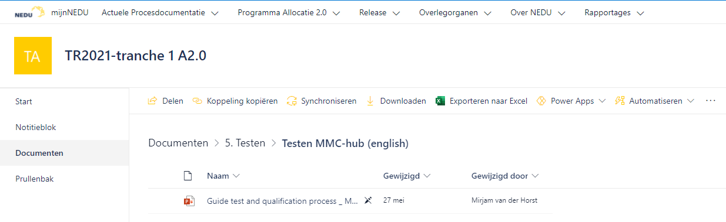
Tests and compulsory pre-qualification MMC Hub
Establishing connection with TenneT
  Information about this can be found on mijnNEDU:
  Allocation2.0/Tranche1 Test and Qualification Guide.ppt
  Allocation2.0/Tranche1 Test and Qualification Guide.ppt on MyTenneT

Slide 21
Tests and compulsory pre-qualification MMC Hub
qualification in TQF
On the TQF environment of TenneT
Check for syntactic accuracy (against the XSD)
Check for semantic rules
Successful qualification offers access to GAT
After pre-qualification environment, market parties must switch from TQF to the qualification environment
RFC TR2021.1 ‘BRS update van versie 1.0 naar 2.0’
  (See document ‘Measurements_Allocations - Technical Guide.pdf’ on MyTenneT)

Slide 22
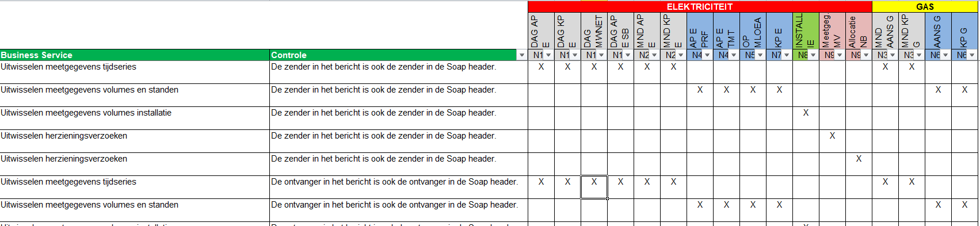
Tests and compulsory pre-qualification MMC Hub
Pre-qualification in TQF
Overview validations in TQF (on mijnNEDU under Tests)

Slide 23
Tests and compulsory qualification MMC Hub
Qualification
On the Qualification environment of TenneT
Takes place during the GAT
The qualification scenarios will be finished together with your GAT group
  This places extra responsibility on the MRP, DSO and TSO in your group
List of qualification scenarios included in the Qualification plan
Qualification scenarios during the GAT include:
  happy flows
  summer/winter time changes
  MRP switch
If the qualification scenarios are successfully completed after the GAT period, you will - as market party - qualify for TR2021 - Tranche 1 Allocatie 2.0

Slide 24
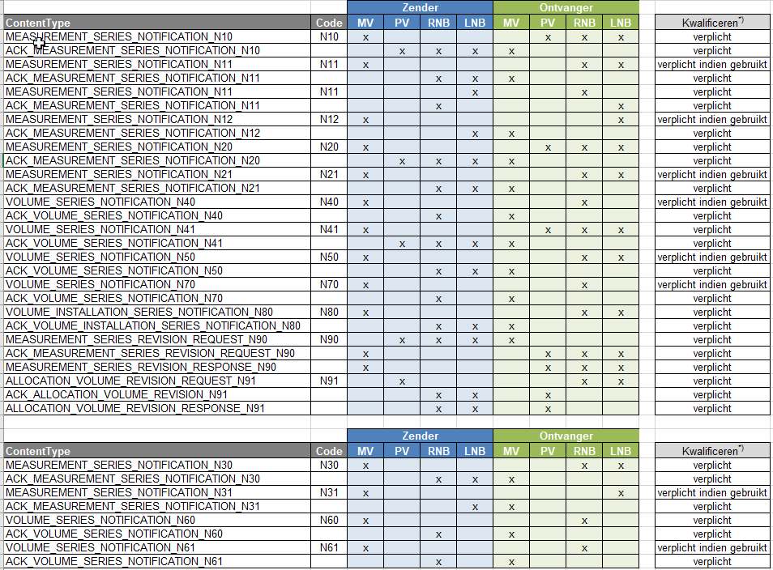
Tests and compulsory pre-qualification MMC Hub

Slide 25
10 minute coffee break

Slide 26
Update tests and transition
Jorik van Vilsteren - Test and Transition manager, EDSN & NEDU

Slide 27
Agenda
What is the Lead group TR2021 - Tranche 1 Allocatie 2.0?
Who are the members of the Lead group TR2021 - Tranche 1 Allocatie 2.0?
Test scenarios
Planning tests
Other useful information …

Slide 28
Lead group TR2021 - Tranche 1 Allocatie 2.0
The Lead group contains frontrunners from the market. They will be first to see the realised functionalities in the central systems
The Lead group contains representatives from TSO-E, TSO-G, DSO, MRP and BRP
The Lead group will perform a jointly agreed set of test scenarios, both progressive and regressive
The Lead group will issue advice for GAT release based on the performed test scenarios
The activities of the Lead group will help to create a more efficient and effective GAT, and eventually a successful implementation

Slide 29
Members of the Lead group TR2021 - Tranche 1 Allocatie 2.0
Market role TSO-E:
  Marco Leensen (TenneT TSO)
Market role TSO-G:
  Nico Dekens (Gasunie)
Market role DSO:
  Fouad Darkaoui (Stedin)
  Alex Lelieveld (Enexis)
  Abel Matahelumual (Liander)
Market role MRP:
  Kemal Kiran (Kenter)
Market role BRP:
  Remco de Kruijk (PVNED)

Slide 30
Test scenarios
The various market parties that participate in the Lead group Tests will jointly establish a pre-agreed set of test scenarios
The results of these test scenarios will be made available to NEDU, and will thus be available to all market parties

Slide 31
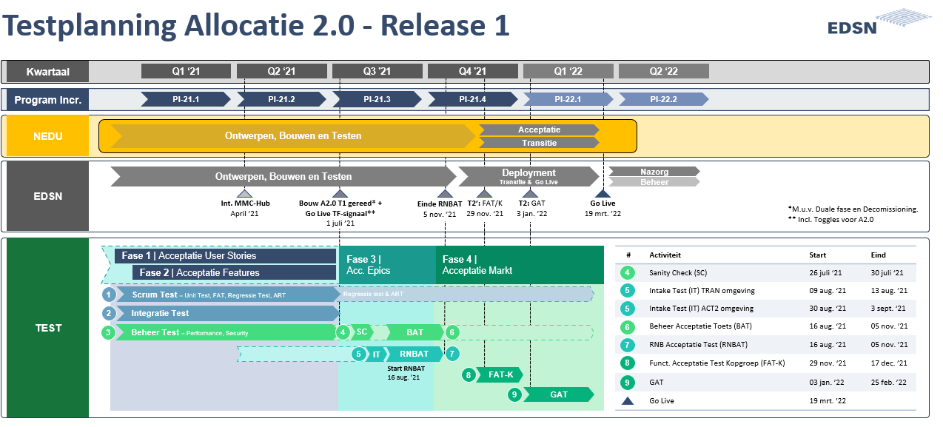
Planning tests
Lead group tests have been scheduled for between 29 November and 17 December 2021

Slide 32
Other useful information …
The tests will be carried out on the following environments:
  C-ARM ACT2
  C-AR ACT
  MMC Hub ACCE environment
EDSN Development & Operations, as well as TenneT TSO OPS, will offer dedicated support during the Lead group test period, so potential findings can be addressed as quickly as possible using a standard findings process
An extra deployment has been claimed in the 2nd and 3rd week to offer the Lead group as much support as possible when fixing and re-testing potential findings

Slide 33
WP test and User Acceptance Test (GAT)
Jorik van Vilsteren - Test and Transition manager, EDSN & NEDU

Slide 34
Agenda
What is the GAT for TR2021 - Tranche 1 A2.0?
GAT group-forming
Planning GAT
Other useful information …

Slide 35
GAT for TR2021 - Tranche 1 A2.0
The GAT is a period of free testing for market parties that have been affected by TR2021 - Tranche 1 Allocatie 2.0
Please note: market parties can qualify themselves for the MMC Hub (TenneT TSO) during the GAT
The results of the GAT (have the pre-established exit criteria been met?) serve as input for the NEDU General Meeting of Members when issuing release advice (go/no go) for go live on 19 March 2022

Slide 36
GAT group-forming
All market parties with market roles DSO, BRP and MRP will be divided across 7 groups (with at least one representative per market role)
GAT group-forming will be announced by 1 November at the latest
Do you have special preferences concerning the groups? Mention them by sending an e-mail to allocatie2.0@edsn.nl

Slide 37
Planning
GAT tests have been scheduled for between 3 January and 25 February 2022

Slide 38
Other useful information …
The tests will be carried out on the following environments:
  C-ARM ACT2
  C-AR ACT
  MMC Hub Q environment
EDSN Development & Operations, as well as TenneT TSO OPS, will offer dedicated support during the GAT test period, to groups that are testing at that moment, so potential findings can be addressed as quickly as possible using a standard findings process

Slide 39
WP transition
Jorik van Vilsteren - Test and Transition manager, EDSN & NEDU

Slide 40
Agenda
Introduction
Planning transition
Consultation group Transition
Follow-up steps transition

Slide 41
Introduction
The Transition work package is also part of the NEDU project TR2021 - Tranche 1 Allocatie 2.0
The Transition work package contains all preparations for a successful go live
A Consultation group Transition has also been set up (more about this later)
This go live will take place during the weekend of 19 - 21 March 2022
A dual phase will take place from 21 March - 14 May 2022

Slide 42
Planning transition
Appendix: Planning scripts TR2021 - Tranche 1 Allocatie 2.0
Preparation
DR1
DR2
GL
August
September
October
November
December
January
February
March
April
May
Focus points and lessons learned
Process and
Technical
Dry run
Go Live
End
dual phase*
Technical
Dry run
Development general outline for Transition per market role
Development Script EDSN / NEDU
(Deployment weekend 19 Mar and 14 May)
Preparation Technical Dry run
Evaluation and preparation Process and Technical Dry run
Preparation Go Live
Overseeing inflow MRP’s into Dual Phase
Development Script EDSN / NEDU Inflow MRP’s (Dual phase)
Develop Roll back and Fall back
Preparation communication Transition
Execution Communication Transition
Dual phase
* Removal of old functionality after dual phase is optional; no central activities for the time being

Slide 43
Consultation group Transition
The Consultation group Transition (KBG) consists of the following members (supplemented by experts wherever necessary):
Ruud Hermans (Stedin)
Marvin Jacobs (Enexis)
Marcel Bingley (Liander)
Edwin Pors (Joulz)
Remco de Kruijk (PVNED)
Klaas de Vries (TenneT TSO)
Nico Dekens (Gasunie)
Daniel van Baar (Eneco)
Bram van Straalen (ALV General Meeting of Members)
Jeroen Kok (EDSN)
Mark Ruiter (EDSN Project Manager TR2021 T1 A2.0)
Jorik van Vilsteren (NEDU / EDSN Manager Transition)
Contact: Do you have questions or comments about the work package Transition TR2021 T1 A2.0? Send an e-mail to allocatie2.0@edsn.nl

Slide 44
Follow-up steps transition
Integral transition script: at this moment in time, we are working hard to compile an integral script for transition TR2021 - Tranche 1 Allocatie 2.0
Consultation group meetings: a Consultation group meeting is held every month, and discusses topical issues
Contact: do you have questions about the work package TR2021 – Tranche 1 Allocatie 2.0? Please contact use via allocatie2.0@edsn.nl

Slide 45
Implementation strategy per market role
Bram van Straalen – DSO expert, member Work group XML Message, member SSR NEDU

Slide 46
Implementation strategy - introduction
Dual phase
  Start 19-3-2021 (go live TR2021)
  End 14-5-2021
During the dual phase, MRP’s select their ‘own moment’ for switching to XML
  The moment must be announced in good time
  Support per MRP using a PAT
  ‘No way back’
  From this ‘own moment’, MRP’s will only receive messages in XML message template
In dual phase
  Some MRP’s will still send metering messages in EDIne
  Some MRP’s already send metering messages in XML
Central systems and systems of grid operators
  MMC Hub (TenneT) → ready for start of dual phase
  TenneT → ready for start of dual phase
  C-ARM (DSO) → ready for start of dual phase
  GTS → ready for start of dual phase
BRP
  Being ready for the start of the dual phase is not a pre-requisite

Slide 47
Implementation strategy - metering messages
Market role | Up to 19-3-2022 | Dual phase | After 14-5-2022
MRP | E65/E66 to DSO | EDIne → XML Moment per MRP | XML to DSO XML to BRP
DSO | E65/E66 from MRP | EDIne → XML Be able to process both EDIne and XML* | XML from MRP
BRP | n/a. | n/a. → XML Able to process XML as of each MRP’s moment** | XML from MRP
* Needed for allocation and billing processes
** BRP’s do not currently receive EDIne metering messages
** Processing by BRP’s is not a prerequisite

Slide 48
Implementation strategy - dispute messages (1)
Use of message template (E73 or XML) in dual phase from DSO/BRP to MRP ‘based on’ template for metering messages
  If an MRP still sends EDIne metering messages → disputes via E73 to this MRP
  If an MRP already sends XML metering messages → disputes via XML to this MRP
Use of message template disputes in dual phase from BRP to DSO (E74 or XML) is free in dual, but:
  if the MRP has switched to XML, the DSO will not send an E73 to this MRP based on the E74
  Therefore, preferably use template based on message template for metering messages MRP

Slide 49
Implementation strategy - dispute messages (2)
Market role | Up to 19-3-2022 | Dual phase | After 14-5-2022
MRP | E73 from DSO | EDIne → XML based on selected moment for metering messages Moment per MRP | XML from DSO XML from BRP
TSO DSO | E74 from BRP E73 to MRP | EDIne → XML Be able to send both EDIne and XML* | XML from BRP XML to MRP
BRP | E74 to DSO | EDIne → XML Be able to send both EDIne and XML** | XML to DSO XML to MRP
* Depending on concerned MRP’s transition moment to XML
** Depending on concerned MRP’s transition moment to XML

Slide 50
Implementation strategy - focus points
Market role | Focus points
MRP | Duly select a moment for switching to XML during dual phase Communicate the selected moment in good time
DSO | Receipt of XML as well as EDIne metering messages must be supported in dual phase Receipt of XML as well as EDIne dispute messages must be supported in dual phase Sending of XML as well as EDIne dispute messages must be supported in dual phase
BRP | Receipt metering messages from MRP is a new process From the moment MRP switches to XML, metering messages will become available to BRP XML metering messages will remain available for collection for ca. 2 weeks in MMC Hub

Slide 51
What do we expect from you?
Questions?
Wrap-up by moderator
Thank you for your attention

